Slide 1
Identifying parts of ecommerce query using query logs
Vijayender Karnaty, Senior Engineer, Target
Varun Galyreddy, Engineer, Target
Vidhya Sundaram, Senior Engineering Manager, Target

Slide 2
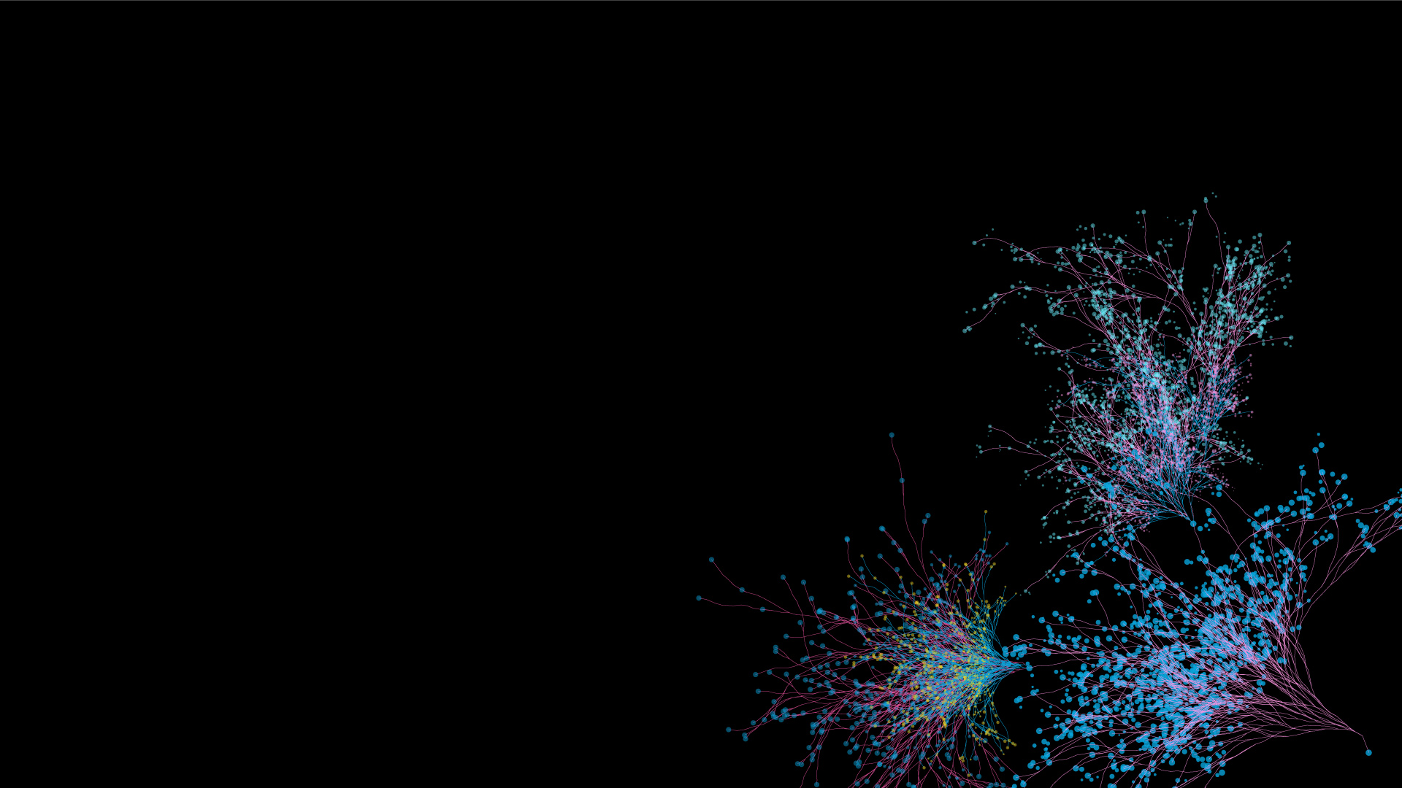

Agenda
Search users sentiments
Challenges in understanding queries
Our Approach
Architecture
Results

Slide 3
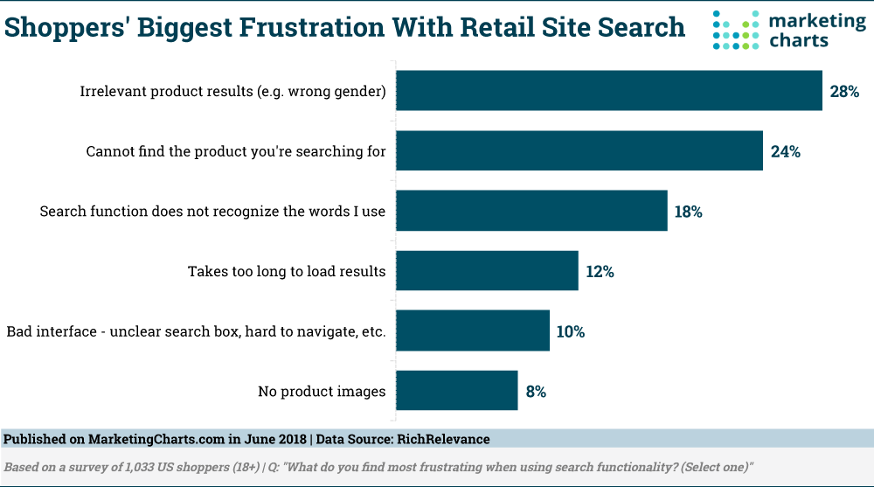
Shoppers’ frustration

Slide 4
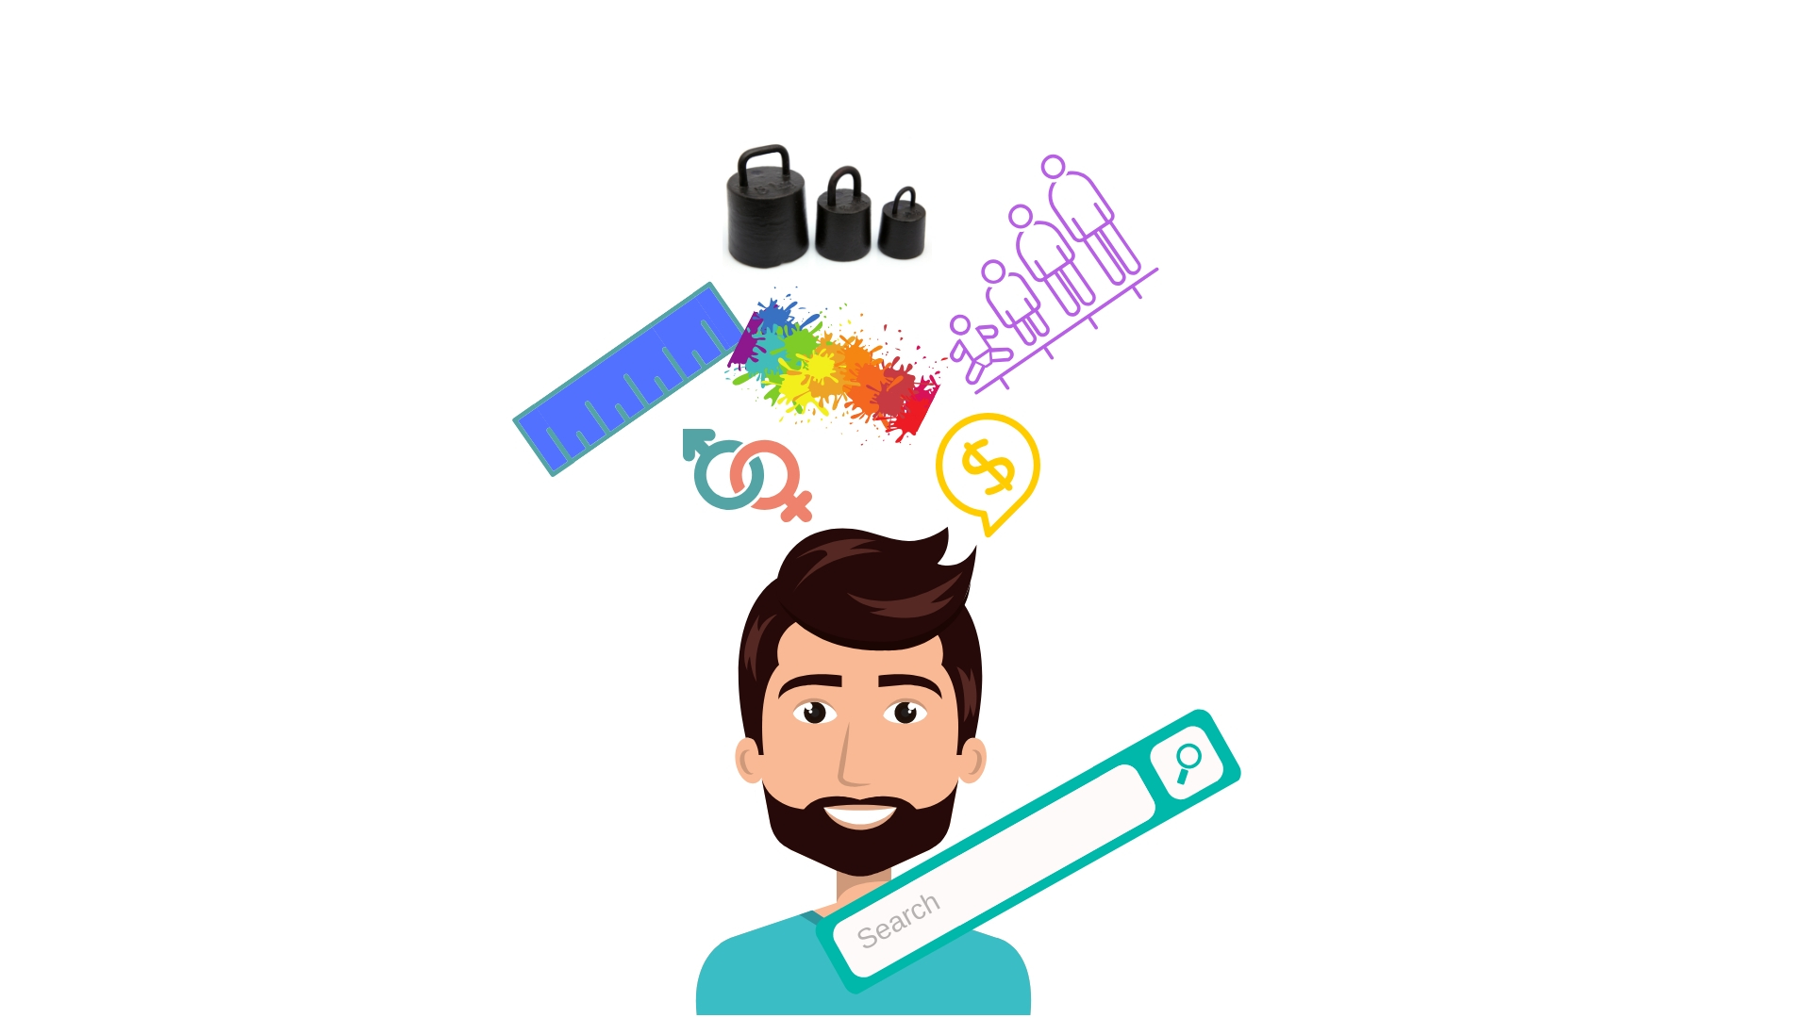
What are users searching for?

Slide 5
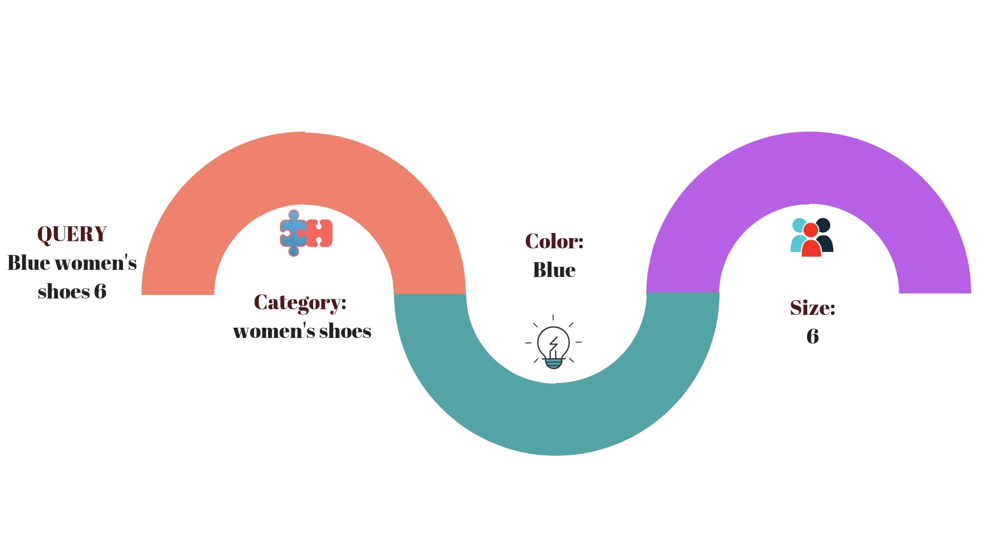
Entities of a user query

Slide 6
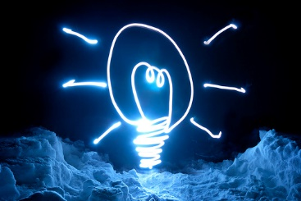



Applications for Search
More Relevant results
Better downstream models
Find products reliably, faster!
Better ROI

Slide 7
Heuristics based entities
POS and NER on query logs
Mine lexical patterns of expression
E.g., Span for POS tags - JJ, DT,IN – around MONEY/DURATION NER tags
Build regex parser that provides coverage for mined patterns

Slide 8
Price and Age - CoreNlp
query | Woman | ‘s | tanks | for | $ | 14.00
POS | NNS | POS | NNS | IN | $ | CD
NER |  |  |  |  | MONEY | MONEY
query | Infant | car | seats | under | 50 | dollars
POS | NN | NN | NNS | IN | CD | NNS
NER |  |  |  |  | MONEY | MONEY
query | Compound | kings | three | pound | slime
POS | NN | NNS | CD | NN | NN
NER |  |  | MONEY | MONEY
query | Elsa | costume | 18 | months
POS | NN | NN | CD | NNS
NER |  |  | DURATION | DURATION
query | 10 | year | old | shoes
POS | CD | NN | JJ | NNS
NER | DURATION | DURATION | DURATION
⨯

Slide 9




Motivation for NN based model
Ex: Cheapest storage bins plastic
Ex : Red DVD, Blue bell ice cream
Ex: black decker mixer

Slide 10
Model
Learn entity tagging from the data
Training data extraction from click logs
Avoid hand written expert rules for entity extraction
Word2Vec
Tackle text data sparsity using distributed word representations
BI-LSTM (Bi-Directional Long Short Term Memory)
Enable sequence to sequence learning
Augmentation Vector
Provide lexical support (catalog lookup information) to the model
Notes:
Introduction and a heuristics based approach

Slide 11
Training Data Extraction
ClickStream Data
ClickStream data
Historical log of query to clicked documents
eCommerce catalogs have well defined attributes
Doc 1
Query
Doc 1
Doc 1
Query
Doc 1
Doc 1
Query
Docs
Doc 1
Docs
Docs
{
"id":"142857",
"title":"Women's Rebecca Pointed Two Piece Ballet Flats - A New Day™",
"category":"Women's shoes",
"sub-category":"flats",
"color":"brown",
"price":"$19.99"
}

Slide 12
Training Data Extraction
Combine both catalog and query log to:
“ Queries with tagged entities ”
Motivational example:
A user queries for “under armor red shoes”
Intersect user search logs with the structured product catalog
under | armor | red | shoes
Brand | Brand | Color | Other

Slide 13
Lexical Support (Augmentation Vector)
Augment with naïve dictionary based tagging
Kinds of lookups encoded:
Exact matches
Phrase lookups with slop
Dictionaries built are looked up using a Lucene index
E.g., Consider a query with tokens “a b c d”, following is encoding info:
 | a | b | c | d
1 token lookup results | score(a) | score(b) | score(c) | score(d)
2 token lookup results | score(ab) | score(bc) | score(cd)
3 token lookup results | score(abc) | score(bcd)
…. | ….
Notes:
Lexical information from catalog -> provide to model - additional input along with query
Dictionary
Scoring -> likelihood
explanation
Generate a sequential input along with query which is sequential
Lookup unigrams, bigrams, trigrams and score ( with the help of lucene )

Slide 14
Lexical Support (Augmentation Vector)
Encode information on:
Presence of phrases in brand/color dictionaries
Lexical relevance of phrases (for brand tagging)
Encoded phrase scores as a sequence
A digestible format for RNNs

Slide 15
Architecture
Click Data
Training data Extraction
Word2Vec
Bidirectional LSTM 3 layer, 100 units
- Sequence modeling - NN classifier -
Tag Probabilities
Query
Vectorize Input
Predicted tag Probabilities
Compute Error
Augment Vector
(Dictionary Lookup)
Back prop

Slide 16
Query
word1 | word2 | word3 | word4
Word Embeddings
..... | ..... | ..... | ..... ..... | ..... | ..... | .....
..... | ..... | ..... | .....
(concat)
Augmentation Vector
w1 | w2 | w3 | w4 w1w2 | w2w3 | w3w4 | 0
w1w2w3 | w2w3w4 | 0 | 0
Model flow: Query to predictions
BiLSTM
Fully Connected layer
Brand prob. Color prob.
Other prob.
predictions
..... | ..... | ..... | ..... ..... | ..... | ..... | .....
..... | ..... | ..... | .....

Slide 17
Model variations
Pretrained Glove vectors
Word2Vec built on internal catalog corpus
Variations | Word error rate
Pretrained Glove vectors | 4.22%
Word2Vec built on internal catalog corpus | 3.99%
Softmax replaced with CRF loss | 4.03%

Slide 18
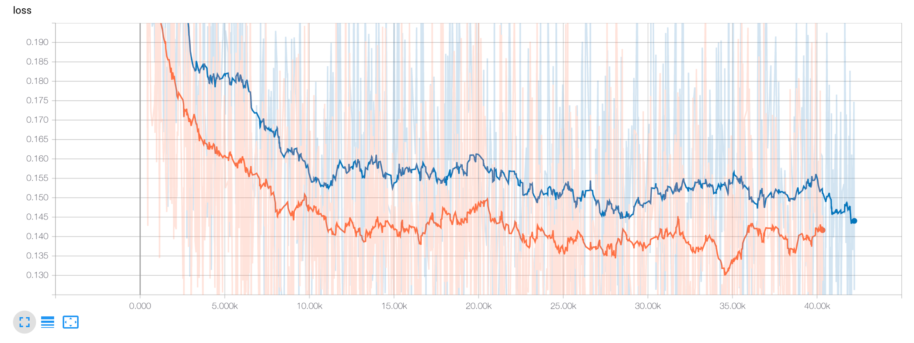
Lexical Support (Augmentation Vector)
Loss with and without the Augmentation Vector
Training loss: aug vec vs without

Slide 19
Results – brand & color
Confusion matrix – against click based tags
Pred → ↓ Labels | other | brand | color
other | 97.76% | 1.70% | 0.53%
brand | 13.63% | 86.28% | 0.08%
color | 9.39% | 1.06% | 89.59%
Pred → ↓ Labels | other | brand | color
other | 97.65% | 1.81% | 0.54%
brand | 14.5% | 85.32% | 0.09%
color | 10.3% | 1.07% | 88.52%
Train data accuracy counts
15% split Test data accuracy counts

Slide 20
Results – brand & color
Tagging long sequences
Notes:
Results categorized
First category

Slide 21
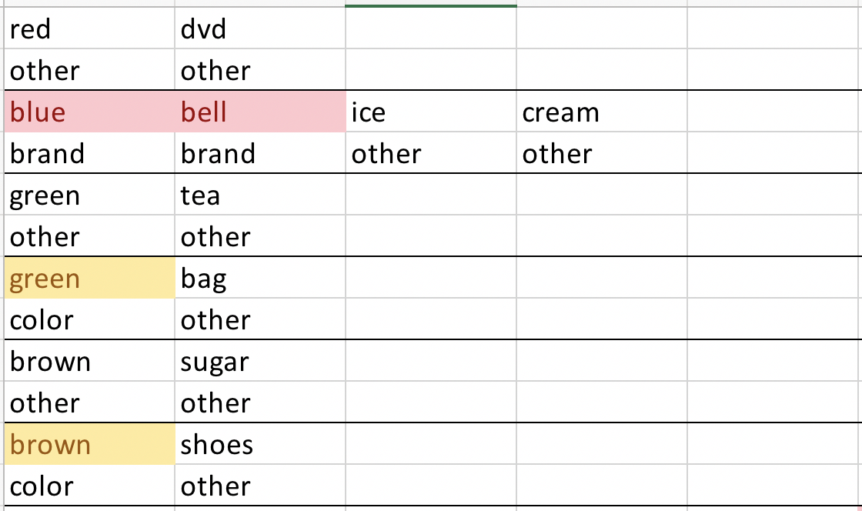
Results – brand & color
Disambiguation

Slide 22
Results – brand & color
Brand variations
Notes:
Tags only variations which are used by customer.

Slide 23


Thank you!
Vijayender Karnaty, Senior Engineer, Target
Varun Galyreddy, Engineer, Target
Vidhya Sundaram, Senior Engineering Manager, Target
@twitterhandle
#Activate18 #ActivateSearch

